Slide 1

Project 4
Alistair Nguyen
Joshua Tean
Neha Sharma

Slide 2


ACT Property Market
Topic one -
Topic two -
Topic three -

Slide 3


Introduction
This year has seen Canberra’s property market take a tumble from the pandemic price peak; however, dwellings still remain $320,000 more expensive on average than before the global pandemic hit in 2020.
Domain’s End of Year Wrap for 2022 revealed median prices were up in Canberra 41.2 per cent than the pandemic trough despite a six per cent median dwelling price decrease since the peak earlier this year.
Chief of Research and Economics at Domain, Dr Nicola Powell, said the overall landscape of Canberra’s property market changed as 2022 progressed and shifted away from 2021 conditions.
Last year, Canberra had the strongest upswing of property prices ever recorded in the city’s history, but as this year progressed, the dial shifted to becoming more in favour of buyers, Dr Powell said.
“Overall, the housing market has tipped in favour of buyers,” she said.
“In the beginning of the year, Canberra had record prices but as the year went on and we saw the RBA hike interest rates and owners battling mortgage affordability.”
.

Slide 4



Topic one
Subtitle

Slide 5
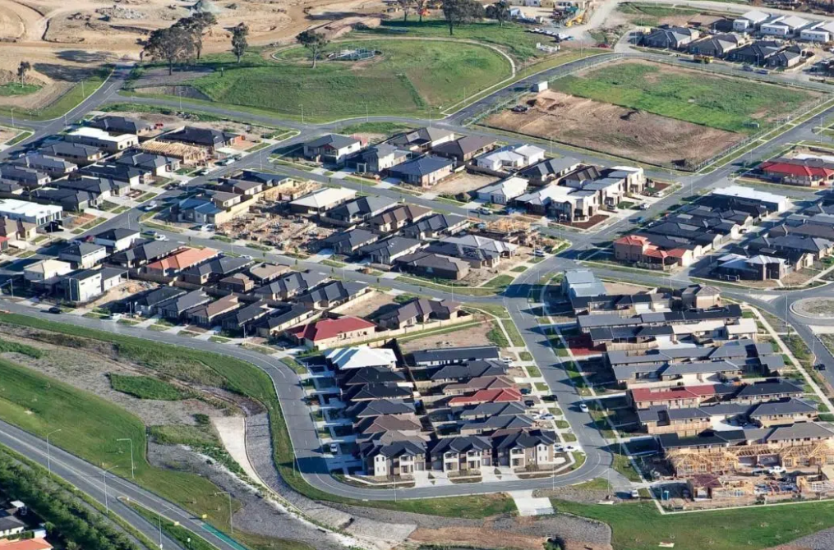
Data Collection
Data extraction
Data Modeling Implementation
Raw data obtained from https://www.kaggle.com/datasets/suryajadahake/australia-property-sales
Pandas used to clean data
All null values and states outside of ACT removed
Three test were conducted across Houses, Townhouse and Units
Narrowed down to Price bedroom and postcode
Logistic Regression and Random Forest Classifier
R-squared testing

Slide 6
Data Modeling Implementation
 | Logistic Regression | Category 2 | Random Forest Classifier | Category 4
 | Training Data Score | Testing Data Score | Training Data Score | Testing Data Score
House | 0.9262910 | 0.9347417 | 0.99217527 | 0.9098591
Townhouse | 0.8769544 | 0.8900203 | 0.9347382 | 0.8431771
Unit | 0.9478295 | 0.9414575 | 0.9621664 | 0.9247311

Slide 7
Data Modeling Implementation
Property Type | R-squared value
House | 0.3646825
Townhouse | 0.4428827
Unit | 0.3359805

Slide 8

Output
Potential data inclusion
House and Land size
Bathrooms
Car space
Quality of the dwelling
Infrastructures proximity

Slide 12

The way to get started is to quit talking and begin doing.
Walt Disney

Slide 13
CHART

Slide 14




team
Name
Name
Name
Name
Title
Title
Title
Title

Slide 15
TIMELINE
Title
To start a presentation, go to the Slide Show tab, and select From Beginning.
Title
To start a presentation, go to the Slide Show tab, and select From Beginning.
Title
During your presentation, the speaker notes are visible on your monitor, but aren't visible to the audience.
Title
Title
The Notes pane is a box that appears below each slide. Tap it to add notes.
If you don’t see the Notes pane or it is completely minimized, click Notes on the task bar across the bottom of the PowerPoint window.

Slide 16
Content
Summary
SUMMARY
Add text, images, art, and videos.
Add transitions, animations, and motion.
Save to OneDrive, to get to your presentations from your computer, tablet, or phone.
Open the Design Ideas pane for instant slide makeovers.
When we have design ideas, we’ll show them to you right there.

Slide 17
Content 2
Summary
summary
summary
Add text, images, art, and videos.
Add transitions, animations, and motion.
Save to OneDrive, to get to your presentations from your computer, tablet, or phone.
Open the Design Ideas pane for instant slide makeovers.
When we have design ideas, we’ll show them to you right there.
This PowerPoint theme uses its own unique set of colors, fonts, and effects to create the overall look and feel of these slides.
PowerPoint has tons of themes to give your presentation just the right personality.

Slide 18




Summary
With PowerPoint, you can create presentations and share your work with others, wherever they are. Type the text you want here to get started. You can also add images, art, and videos on this template. Save to OneDrive and access your presentations from your computer, tablet, or phone.

Slide 19

Thank you
Presenter Name
Email Address
Website Address

